Slide 1
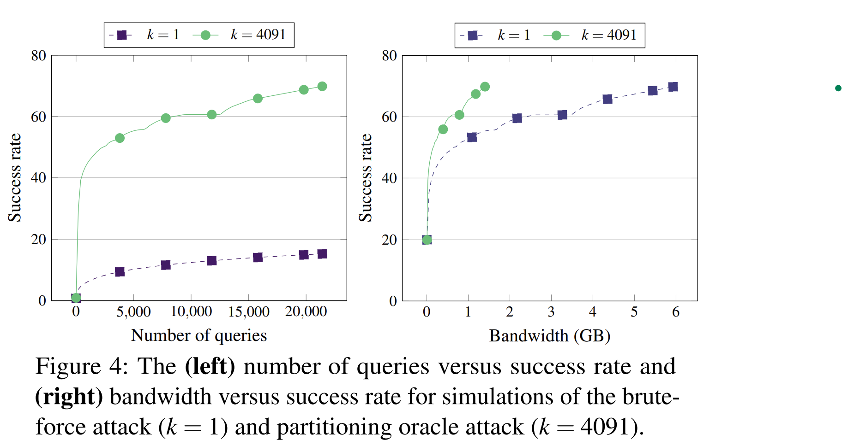
Case Shadowsocks
Success rate simulations:
For success rates above 25%, the partitioning oracle attack requires less total bandwidth than brute-force
One partitioning oracle query: 65,532 bytes
One brute-force query: 68 bytes
Notes:
Left: graph of number of queries vs success rate
Right: graph of bandwidth in GB vs success rate
Overall, partitioning oracle attack outperform brute force attack for all query budget
POA requires more bandwidth than brute force (65,532 vs 68) in single query, but for success rates above 25%, the POA requires less total bandwidth than brute force due to less queries needed

Slide 2



Experimental Evaluation [Proof of Concept]:
Pre-computation phase
Compute 200 password sets: 33 hours (10 min/ password set)
Compute 200 MKCR ciphertexts: 92 minutes (28 sec/ ciphertext)
Querying phase
Sending 200 ciphertexts: 20 seconds, 13.1 MB of bandwidth
Port scan: 97 seconds, 1.36MB of bandwidth (20-byte payload to each port)\
Trial decryption: 58 seconds for 392,179 decryptions
200 ciphertexts
~20% success probability
818,200 passwords
Linux desktop (pre-computation phase)
Ubuntu E2C micro instance (querying phase)
Ubuntu E2C micro instance
Go-shadowsocks2
Notes:
Pre-comp:
One could speed up this precomputation step via parallelization and by focusing on only higher probability passwords (instead of the entire set, as these timings reflect)
Query:
program waited 100 ms between each ciphertext to avoid overloading the server, hence require 20s
used the python3 scapy library to send a 20-byte payload to every port in the range 32,768 to 60,999.

Slide 3
Summary
An Encrypted proxy for TCP/UDP traffic, based on SOCKS5
Disclosed the attack to Shadowsocks developers who disabled UDP proxying where enabled by default
[Open problem] When author found an attack for an UDP traffic, the attack does not work for TCP because the TCP protocol requires finding a multi-collision for smaller than a block of ciphertext.
While brute-force dictionary attack is damaging, partitioning oracle attacks performs better in query-limited settings

Slide 4
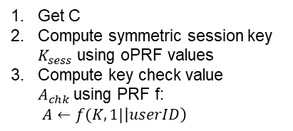
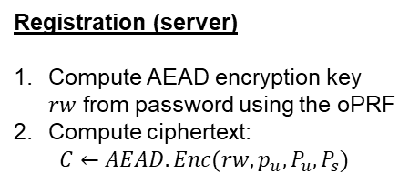
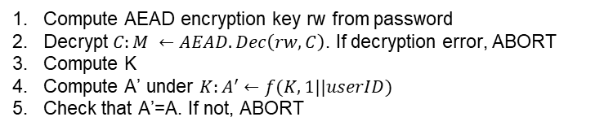
About:
Was chosen by the IETF CFRG for standardization in 2018
Meant to replace the existing password authentication protocols on the web
Consider for the case when implementation deviate from the standard by using a non-committing
Composes an oblivious PRF (oPRF) with a committing AEAD
Overview:
Registration (server)
Compute AEAD encryption key $rw$ from password using the oPRF
Compute ciphertext:
$$C←AEAD.Enc(rw, p_{u}, P_{u}, P_{s})$$
Login
oPRF values, userID
Get C
Compute symmetric session key $K_{sess}$ using oPRF values
Compute key check value $A_{chk}$using PRF f:
$A←f(K, 1|\left|userID\right)$
oPRF values, C, A
Compute AEAD encryption key rw from password
Decrypt $C:M ←AEAD.Dec\left(rw, C\right)$. If decryption error, ABORT
Compute K
Compute A’ under $K:A^{′}←f(K, 1||userID)$
Check that A’=A. If not, ABORT

Slide 5
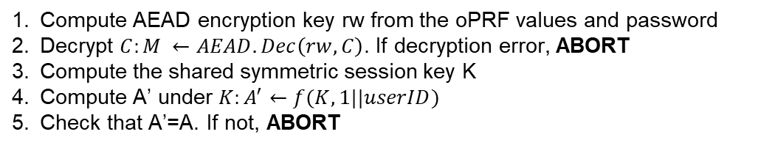
Attack:
Compute key multi-collision ciphertext C*
Choose oPRF values and random key check value A
oPRF values, C*, A
Compute AEAD encryption key rw from the oPRF values and password
Decrypt $C:M ←AEAD.Dec\left(rw, C\right)$. If decryption error, ABORT
Compute the shared symmetric session key K
Compute A’ under $K:A^{′}←f(K, 1||userID)$
Check that A’=A. If not, ABORT
Notes:
Theres 2 places where ABORT situation will happens.
1. first ABORT tells the attacker that decryption fails => tells the attacker that the client password is not in this set of password
2. second ABORT tells the attacker that the decryption succeeded and the password is in this set
Distinct error report will easily tell the attacker whether a particular spliiting ciphertext was successfully decrypted
OPAQUE protocol does make clear that committing AEAD shud be used, which will prevent this attack

Slide 6
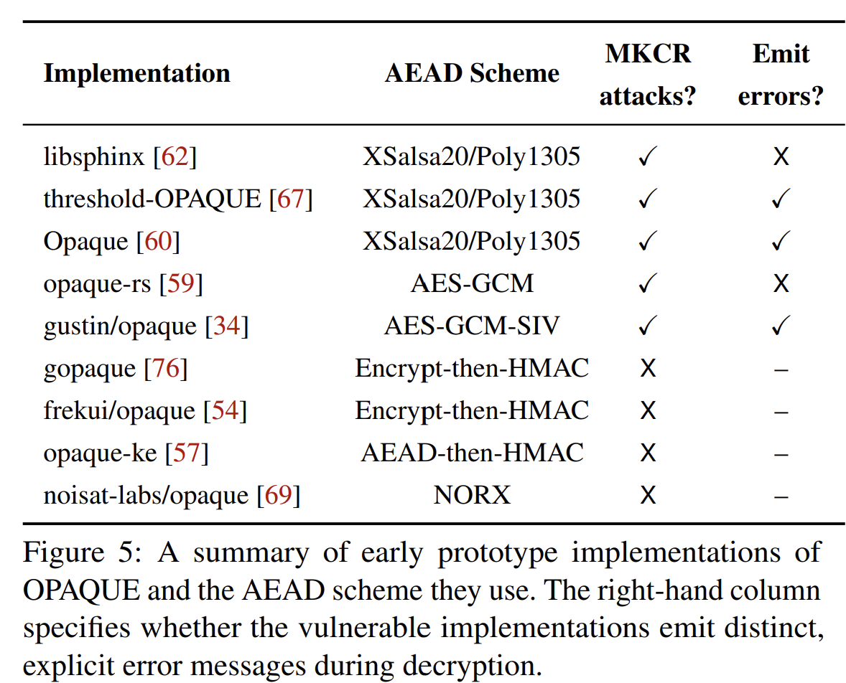
3 out of 5 vulnerable implementations emit distinct, explicit error messages during decryption
Notes:
However some early implementation of OPAQUE does not follow and did not use committing AEAD
Found out 5 out of 9 implementation used non-committing AEAD scheme despite opaque author’s specification
3 out of 5 vulnerable implementations emit distinct, explicit error messages during decryption. Which allow attacker easily to determine whether a splitting ciphertext was successfully decrypted or not
Q: is the attack still possible without these distinct error messages

Slide 7
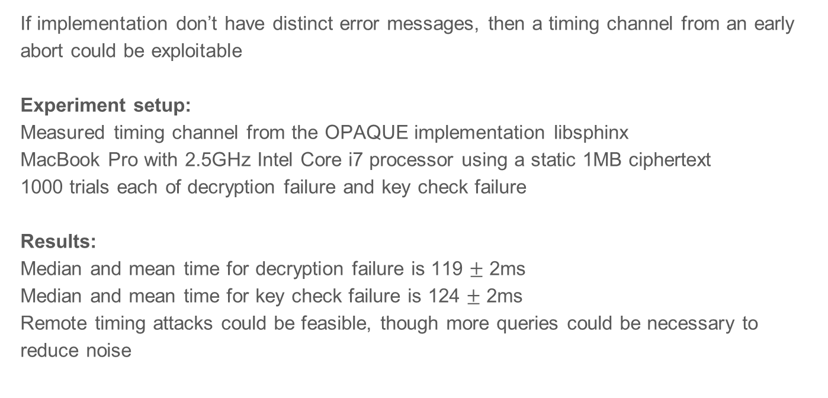
If implementation don’t have distinct error messages, then a timing channel from an early abort could be exploitable
Experiment setup: Measured timing channel from the OPAQUE implementation libsphinx
MacBook Pro with 2.5GHz Intel Core i7 processor using a static 1MB ciphertext
1000 trials each of decryption failure and key check failure
Results:
Median and mean time for decryption failure is 119 $±$ 2ms
Median and mean time for key check failure is 124 $±$ 2ms
Remote timing attacks could be feasible, though more queries could be necessary to reduce noise

Slide 8
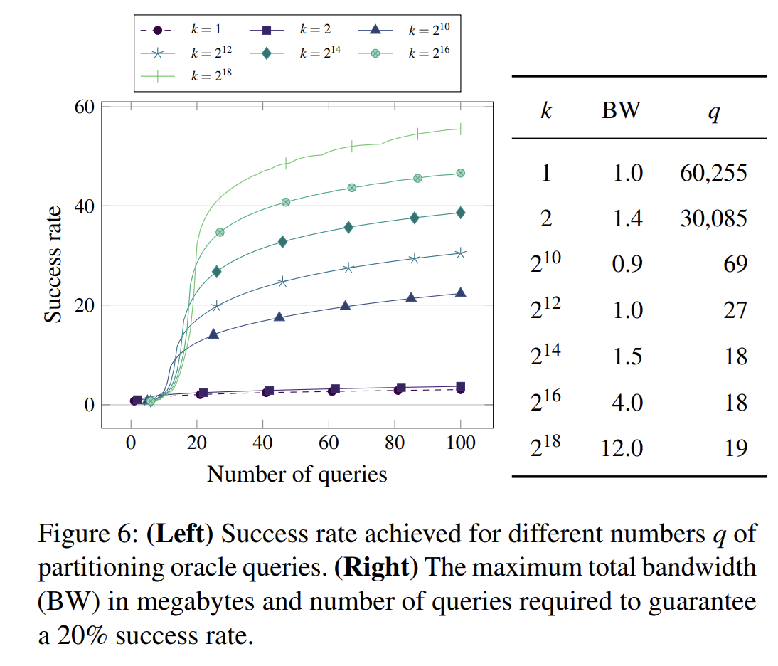
Experiment setup:
Simulations using the datasets used for the Shadowsocks experiments
Compute the success rate of passwords recovered for up to 100 partitioning oracle queries
Maximum success rate: 70%
The maximum total bandwidth and number of queries needed to guarantee a 20% success rate
Notes:
Graph number of queries vs success rate:
Number of password can check for each queries
The greater value of k, the greater of success rate can achieve
Interesting observation when k=2^10 bandwidth needed is less than k=1, because smaller ciphertext size in combination fewer queriesx

Slide 9
Some other possible partitioning oracle attack
Hybrid encryption: Hybrid Public-key encryption (HPKE)
Age file encryption tool
Kerberos drafts (not adopted)
JavaScript Object Signing and Encryption (JOSE)
Anonymity systems: use partitioning oracles to learn which public key a recipient is using from a set of public keys

